Slide 1
IT2060/IE2061
Operating Systems and System Administration
Lecture 08
Memory Management
U. U. Samantha Rajapaksha
M.Sc.in IT, B.Sc.(Engineering) University of Moratuwa
Senior Lecturer SLIIT
Samantha.r@slit.lk

Slide 2
Chapter 8: Memory Management
Background
Swapping
Contiguous Memory Allocation
Paging

Slide 3
Main Memory – Chapter 8
Memory is a large array of words or bytes, each with its own address
It is a repository of quickly accessible data shared by CPU and I/O devices.
Memory and registers are the only storage that CPU can directly access
Main memory is a volatile storage device
It loses its contents in the case of system failure.
A program must be mapped to absolute addresses and loaded into memory.
Selection of a memory management scheme for a specific system depends on many factors, especially on the hardware design of the system.
The OS is responsible for the following activities:
Keep track of which parts of memory are being used and by whom.
Decide which processes to load next when memory space becomes available.
Allocate and deallocate memory.
CPU
Memory
I/O

Slide 4
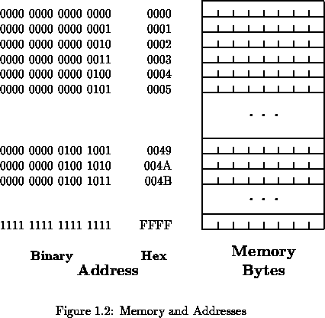
For n bits address, the memory capacity = 2^{n} bytes

Slide 5
Background
Program must be brought (from disk) into memory and placed within a process for it to be run
Main memory and registers are only storage CPU can access directly
Memory unit only sees a stream of addresses + read requests, or address + data and write requests
Register access in one CPU clock (or less)
Protection of memory required to ensure correct operation

Slide 6
Address Binding
Programs on disk, ready to be brought into memory to execute form an input queue
Without support, must be loaded into address 0000
Inconvenient to have first user process physical address always at 0000
How can it not be?
Further, addresses represented in different ways at different stages of a program’s life
Source code addresses usually symbolic
Compiled code addresses bind to relocatable addresses
i.e. “14 bytes from beginning of this module”
Linker or loader will bind relocatable addresses to absolute addresses
i.e. 74014
Each binding maps one address space to another

Slide 7
Binding of Instructions and Data to Memory
Address binding of instructions and data to memory addresses can happen at three different stages
Compile time: If memory location known a priori, absolute code can be generated; must recompile code if starting location changes
Load time: Must generate relocatable code if memory location is not known at compile time
Execution time: Binding delayed until run time if the process can be moved during its execution from one memory segment to another
Need hardware support for address maps (e.g., base and limit registers)

Slide 8
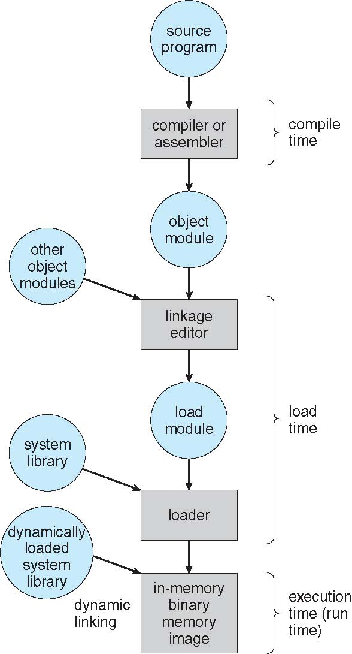
Multistep Processing of a User Program

Slide 9
Logical vs. Physical Address Space
The concept of a logical address space that is bound to a separate physical address space is central to proper memory management
Logical address – generated by the CPU; also referred to as virtual address
Physical address – address seen by the memory unit
Logical and physical addresses are the same in compile-time and load-time address-binding schemes; logical (virtual) and physical addresses differ in execution-time address-binding scheme
Logical address space is the set of all logical addresses generated by a program
Physical address space is the set of all physical addresses generated by a program

Slide 10
Swapping
A process can be swapped temporarily out of memory to a backing store, and then brought back into memory for continued execution
Total physical memory space of processes can exceed physical memory
Backing store – fast disk large enough to accommodate copies of all memory images for all users; must provide direct access to these memory images
Roll out, roll in – swapping variant used for priority-based scheduling algorithms; lower-priority process is swapped out so higher-priority process can be loaded and executed
Major part of swap time is transfer time; total transfer time is directly proportional to the amount of memory swapped
System maintains a ready queue of ready-to-run processes which have memory images on disk

Slide 11
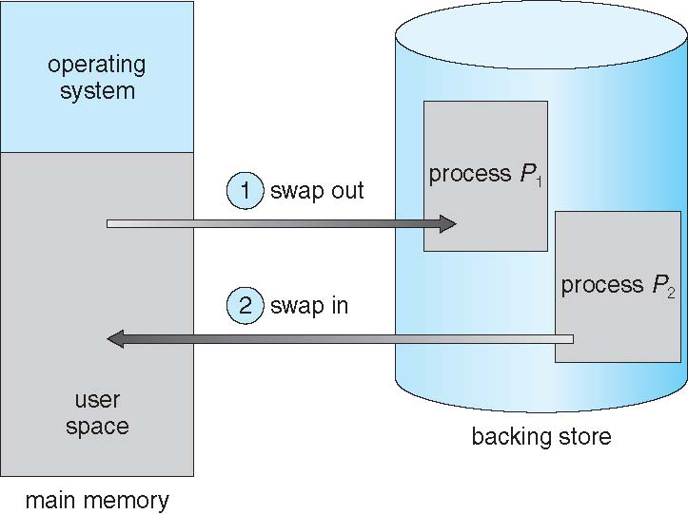
Schematic View of Swapping

Slide 12
Contiguous Allocation
Main memory must support both OS and user processes
Limited resource, must allocate efficiently
Contiguous allocation is one early method
Main memory usually into two partitions:
Resident operating system, usually held in low memory with interrupt vector
User processes then held in high memory
Each process contained in single contiguous section of memory

Slide 13
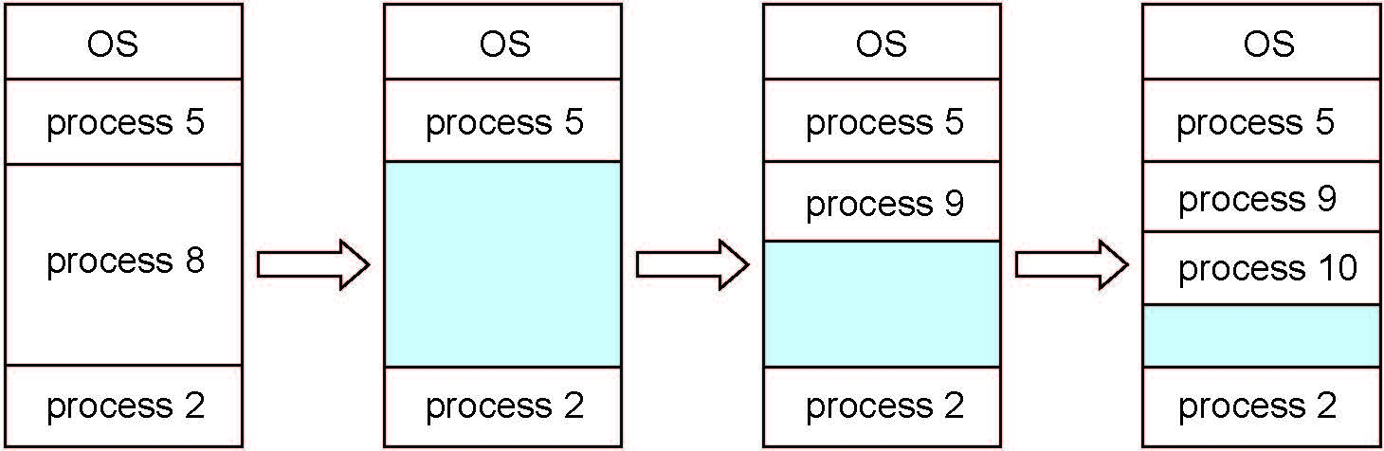
Multiple-partition allocation
Multiple-partition allocation
Degree of multiprogramming limited by number of partitions
Variable-partition sizes for efficiency (sized to a given process’ needs)
Hole – block of available memory; holes of various size are scattered throughout memory
When a process arrives, it is allocated memory from a hole large enough to accommodate it
Process exiting frees its partition, adjacent free partitions combined
Operating system maintains information about: a) allocated partitions b) free partitions (hole)

Slide 14
Dynamic Storage-Allocation Problem
How to satisfy a request of size n from a list of free holes?
First-fit: Allocate the first hole that is big enough
Best-fit: Allocate the smallest hole that is big enough; must search entire list, unless ordered by size
Produces the smallest leftover hole
Worst-fit: Allocate the largest hole; must also search entire list
Produces the largest leftover hole
First-fit and best-fit better than worst-fit in terms of speed and storage utilization

Slide 15
Fragmentation
External Fragmentation – total memory space exists to satisfy a request, but it is not contiguous
Internal Fragmentation – allocated memory may be slightly larger than requested memory; this size difference is memory internal to a partition, but not being used
First fit analysis reveals that given N blocks allocated, 0.5 N blocks lost to fragmentation
1/3 may be unusable -> 50-percent rule

Slide 16
Fragmentation (Cont.)
Reduce external fragmentation by compaction
Shuffle memory contents to place all free memory together in one large block
Compaction is possible only if relocation is dynamic, and is done at execution time
I/O problem
Latch job in memory while it is involved in I/O
Do I/O only into OS buffers
Now consider that backing store has same fragmentation problems

Slide 17
Paging
Physical address space of a process can be noncontiguous; process is allocated physical memory whenever the latter is available
Avoids external fragmentation
Avoids problem of varying sized memory chunks
Divide physical memory into fixed-sized blocks called frames
Size is power of 2, between 512 bytes and 16 Mbytes
Divide logical memory into blocks of same size called pages
Keep track of all free frames
To run a program of size N pages, need to find N free frames and load program
Set up a page table to translate logical to physical addresses
Backing store likewise split into pages
Still have Internal fragmentation

Slide 18
Address Translation Scheme
Address generated by CPU is divided into:
Page number (p) – used as an index into a page table which contains base address of each page in physical memory
Page offset (d) – combined with base address to define the physical memory address that is sent to the memory unit
For given logical address space 2^{m} and page size 2^{n}

Slide 19
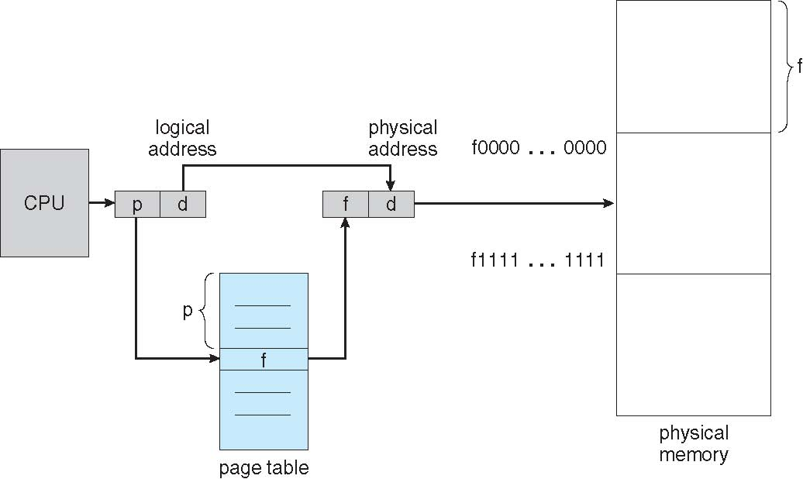
Paging Hardware

Slide 20
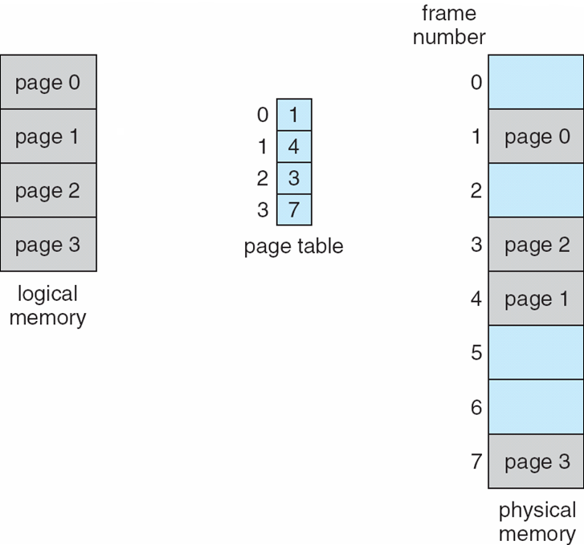
Paging Model of Logical and Physical Memory

Slide 21
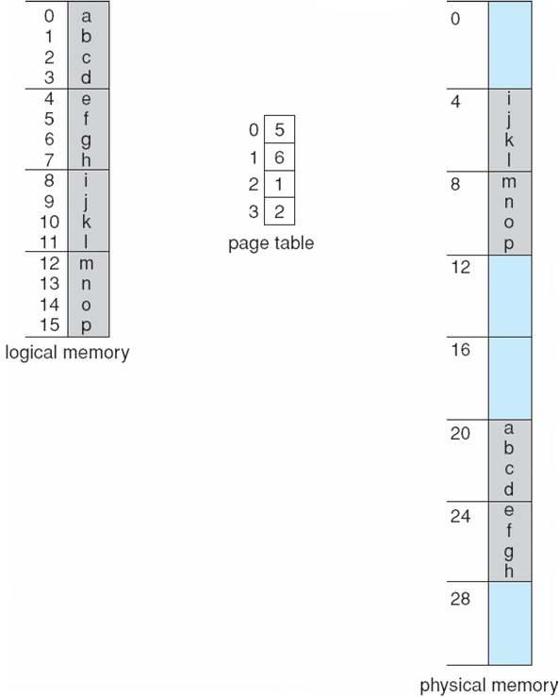
Paging Example
n=2 and m=4 32-byte memory and 4-byte pages

Slide 22
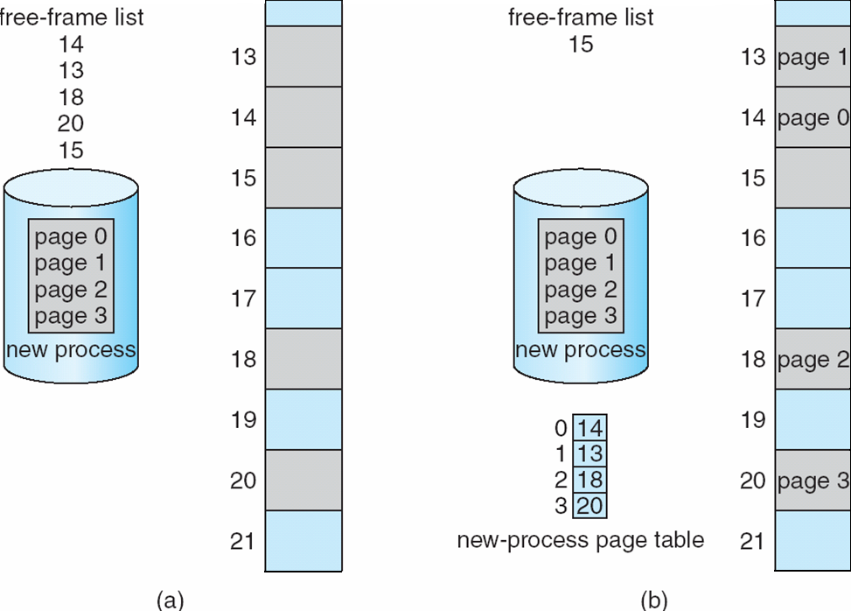
Free Frames
Before allocation
After allocation

Slide 23
Associative Memory
Associative memory – parallel search
Address translation (p, d)
If p is in associative register, get frame # out
Otherwise get frame # from page table in memory

Slide 24
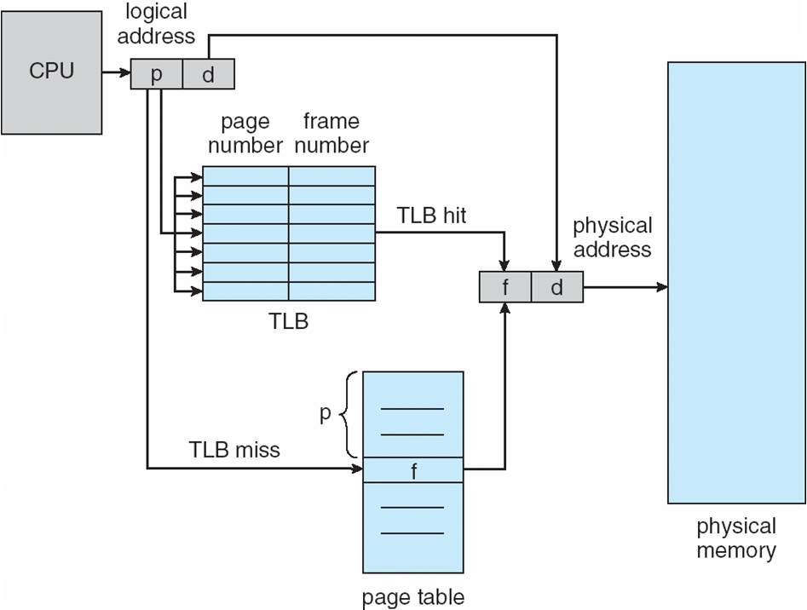
Paging Hardware With TLB

Slide 25
Effective Access Time
Associative Lookup = ε time unit
Can be < 10% of memory access time
Hit ratio = α
Hit ratio – percentage of times that a page number is found in the associative registers; ratio related to number of associative registers
Consider α = 80%, ε = 20ns for TLB search, 100ns for memory access
Effective Access Time (EAT)
EAT = (1 + ε) α + (2 + ε)(1 – α)
= 2 + ε – α
Consider α = 80%, ε = 20ns for TLB search, 100ns for memory access
EAT = 0.80 x 100 + 0.20 x 200 = 120ns
Consider more realistic hit ratio -> α = 99%, ε = 20ns for TLB search, 100ns for memory access
EAT = 0.99 x 100 + 0.01 x 200 = 101ns

Slide 26
Memory Protection
Memory protection implemented by associating protection bit with each frame to indicate if read-only or read-write access is allowed
Can also add more bits to indicate page execute-only, and so on
Valid-invalid bit attached to each entry in the page table:
“valid” indicates that the associated page is in the process’ logical address space, and is thus a legal page
“invalid” indicates that the page is not in the process’ logical address space
Or use page-table length register (PTLR)
Any violations result in a trap to the kernel

Slide 27
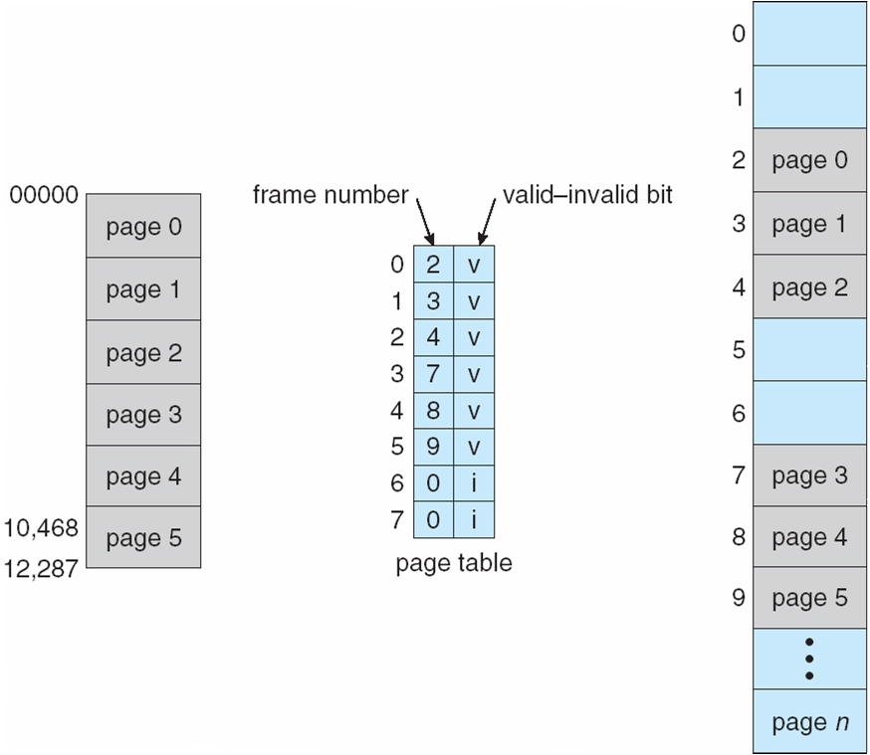
Valid (v) or Invalid (i) Bit In A Page Table

Slide 28
Page Table Structure
Hierarchical Paging.
Hashed Page Tables.
Inverted Page Tables.
Hierarchical Paging
Most modern computer systems support a very large logical address, e.g., 2³² to 2⁶⁴ → page table becomes very large.
Example: For a system with 32 bit logical address, and page size = 4KB (12 bits offset)
page table = 1 Million entries (32-12 = 20 bits) → 4 MB of physical address spaces for page table; 2²⁰ * 4 bytes/entry
One solution is to divide the page table into smaller pieces
For a two-level paging scheme, the page table itself is also paged.

Slide 29
Two-level paging example
A logical address (on 32-bit machine with 4K page size) is divided into:
a page number consisting of 20 bits.
a page offset consisting of 12 bits.
Since the page table is paged, the page number is further divided into:
a 10 bit page number.
a 10 bit page offset.
Thus, a logical address is as follows:
Page number
Page offset
p₁ p₂ d
10
10
12
p₁ is an index into the outer page table, and p₂ is the displacement within the page of the inner page table
Translation starts from the outer page table

Slide 30
Two-level paging example
1
1
.
500
100
500
100
.
708
708
900
Outer-page table
929
900
.
929

Slide 31
Address-translation scheme
Two-level 32-bit paging architecture
Logical address
p₁ p₂ d
p₁
p₂
d
Outer-page table
Page of page table

Slide 32
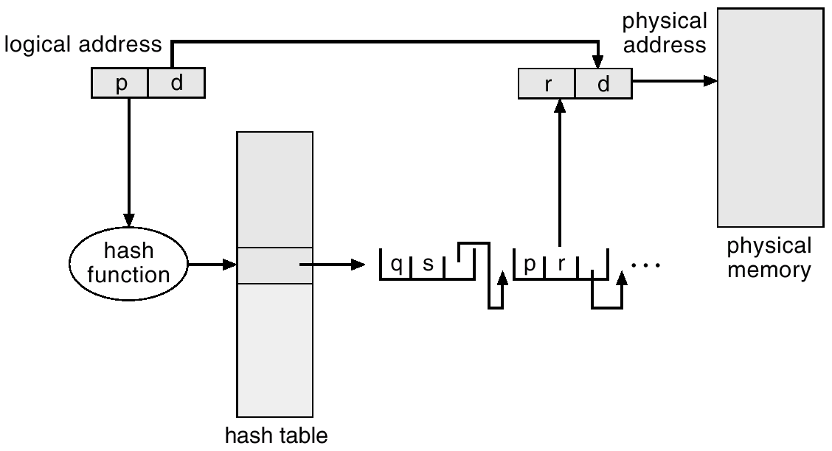
Hashed Page Tables
Is commonly used when address spaces > 32 bits.
The virtual page number is hashed into a page table.
This page table contains a chain of elements hashing to the same location.
Each element contains: virtual page number, the value of the mapped frame, pointer to the next element
Virtual page number is compared in this chain searching for a match.
If a match is found, the corresponding physical frame is extracted.
For address spaces > 64 bits, use Clustered page tables.
Similar to hash page table except each entry in page table refers to several pages (e.g., 16).

Slide 33
Inverted Page Table
In the paging system, each process has a page table associated with it.
Drawback: each page table may consist of millions of entries → page tables consume large amount of physical memory.
To solve this problem, use Inverted Page Table.
It uses ONLY one table that has one entry for each real page of memory.
Each entry consists of the virtual address of the page stored in that real memory location, with information about the process (e.g., PID) that owns that page.
This scheme decreases memory needed to store each page table, but increases time needed to search the table when a page reference occurs.
It may use hash table to limit the search to one – or at most a few page table entry.

Slide 34
Inverted page table architecture
Logical address
Physical
memory
CPU
pid p d
i d
physical address
search
Pid p
i
Page table

Slide 35
Shared pages
Other advantage of paging is the possibility of sharing common code (reentrant code also called pure code).
Reentrant code is non-self-modifying code → its code never change during execution.
Shared code.
One copy of read-only (reentrant) code shared among processes (i.e., text editors, compilers, window systems).
Private code and data.
Each process keeps a separate copy of the code and data.
The pages for the private code and data can appear anywhere in the logical address space.

Slide 36
Shared pages example
Process p₁
Page table for p₁
0
data 1
data 3
ed 1
ed 2
ed 3
data 2
ed 1
ed 2
ed 3
data 1
3
4
6
1
1
Process p₂
2
ed 1
ed 2
ed 3
data 2
3
4
6
7
3
4
5
Process p₃
Page table for p₃
6
ed 1
ed 2
ed 3
data 3
Page table for p₂
7
3
4
6
2
8
9
10

Slide 37
Segmentation
Memory management with paging makes separation between user view of memory and the actual physical memory.
Segmentation is memory-management scheme that supports user view of memory.
From user’s view, a program is a collection of segments, and a segment is a logical unit such as:
Main program.
Procedure / Function.
Local variables, global variables.
Common block.
Stack.
Symbol table, arrays.
Each segment has a name and length; the addresses specify both the segment name and an offset.
Program specifies each address by two quantities: a segment name, and an offset (within the segment).

Slide 38
Logical view of segmentation
Physical memory
User space memory
1
4
2
3
1
2
3
4

Slide 39
Segmentation architecture
Logical address consists of a two tuple: <segment-number, offset>.
Segment table – maps two-dimensional user-defined addresses into one-dimensional physical addresses.
Each table entry has:
Base – contains the starting physical address where the segments reside in memory.
Limit – specifies the length of the segment.
Segment-table base register (STBR) points to the segment table’s location in memory.
Segment-table length register (STLR) indicates the number of segments used by a program;
segment number s is legal if s < STLR.

Slide 40
Segmentation architecture (cont.)
Sharing.
Shared segments.
Same segment number.
Allocation
First fit/best fit.
External fragmentation.
Protection
With each entry in segment table associate:
Validation bit = 0 → illegal segment.
Read/write/execute privileges.
Protection bits associated with segments; code sharing occurs at segment level.
Since segments vary in length, memory allocation is a dynamic storage-allocation problem.

Slide 41
Segmentation Hardware
s
limit base
memory
CPU
s d
yes
Physical address
<
+
no
Trap; addressing error

Slide 42
Logical memory process P₁
editor
Editor
Data 1
Data 2
Segment 0
43062
Data 1
Segment 1
68348
72773
90003
Segment table process P₁
98553
Logical memory process P₂
Physical memory
limit
base
editor
0
25286
43062
Segment 0
Data 2
1
8850
90003
Segment 1
Segment table process P₂

